Slide 1



Cloud Architecture of an E-Commerce Platform
Patterns and Artificial Intelligence for Cloud and Cloud-Edge Continuum
Companion website: https://dub.sh/11913446-cloud-arch

Slide 2

Application Overview

Slide 3
Rationale
Online selling is becoming more popular.
Small and medium businesses face high barriers to entry in the market
E-commerce marketplaces offer a solution by providing a platform for vendors to list and sell their products
The marketplace takes a commission on each sale and handles platform development and maintenance
The marketplace also provides advertising and review capabilities for vendors and buyers

Slide 4
Functional Requirements
Customers can register and login to the system
Vendors can register and list their products
Vendors can promote their products for a period of time
Promoted products appear for users automatically based on their preferences and real-time interactions with the system
Customers can search for products and observe them in detail, with support for image recognition
Customers can buy products
Customers can choose from payment methods such as credit card, PayPal, and bank transfer
Customers can leave ratings and reviews for products
Customers can connect with vendors in built-in chat rooms
The system detects fraudulent activities and blocks the corresponding accounts

Slide 5
Non-Functional Requirements
The system should be highly available across the globe
The system should have extremely low latency to ensure a good user experience and the maximization of conversions
The system should be scalable to handle a large number of concurrent users
The system should tolerate spikes in traffic (e.g. before Holidays, Black Friday, etc.)
The system should be secure and protect customer and vendor data, compliant with local and international laws
Data-loss should be prevented to maximize the satisfaction of customers and vendors

Slide 6

Architecture Overview

Slide 7
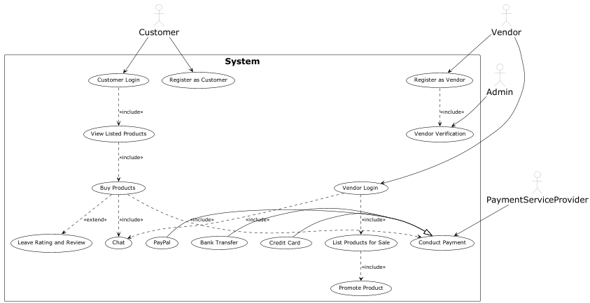
Use Cases

Slide 8
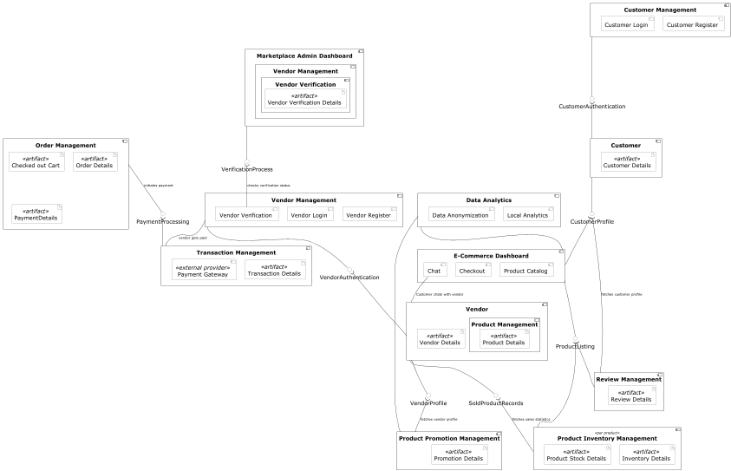
Components

Slide 9

Role of Edge Computing and AI in the System

Slide 10
Making Use of Edge Computing
Every millisecond counts when it comes to conversions
Joint research of Google and Deloitte: “milliseconds make millions”
Targeted ads and personalized recommendations
Collection and processing of user data in real time
Complying wuth local data privacy regulations
Data is processed as close to the user as possible

Slide 11
Making Use of AI Components
Product search with image recognition and object detection
Users can browse listings based on images and descriptions
Detecting fraudulent activities
Fake accounts, reviews, transactions can be detected in real-time
AI-based advertisements
Users are prompted with ads and recommendations relevant for them

Slide 12
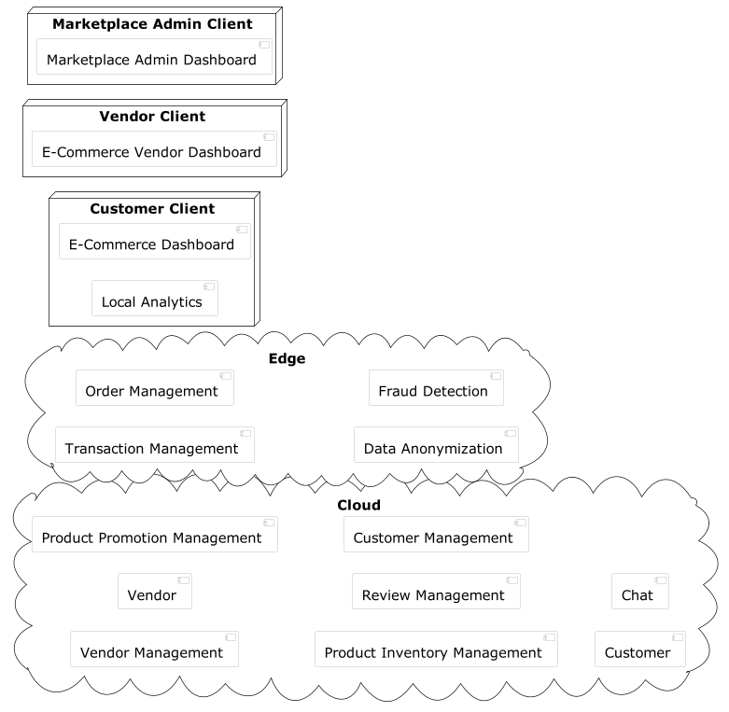
Deployments

Slide 13

Vendor Agnostic Cloud Patterns

Slide 14


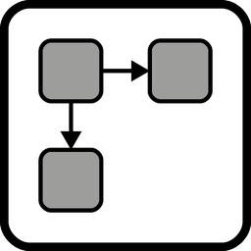





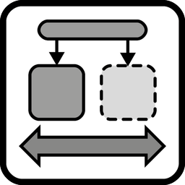

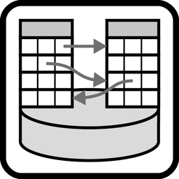
Overview of the Identified Patterns
Public Cloud
CDN
Distributed Application
UI Component
Data Access Component
Stateful Component
Exactly-once Delivery
Unpredictable Workload
Elastic Load Balancer
Key-value Storage
Relational Database

Slide 15
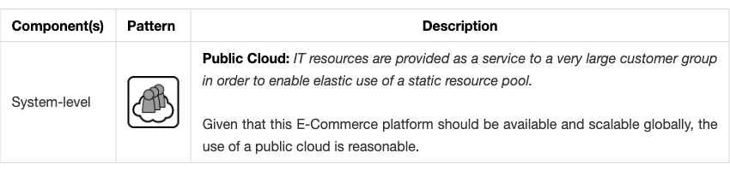
Cloud Service Models & Cloud Deployment Types

Slide 16
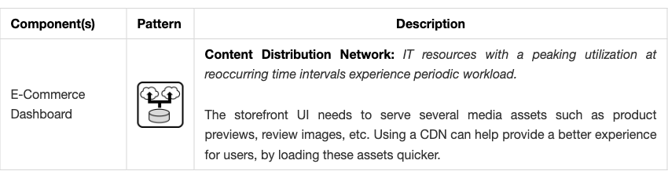
Native Cloud Applications

Slide 17
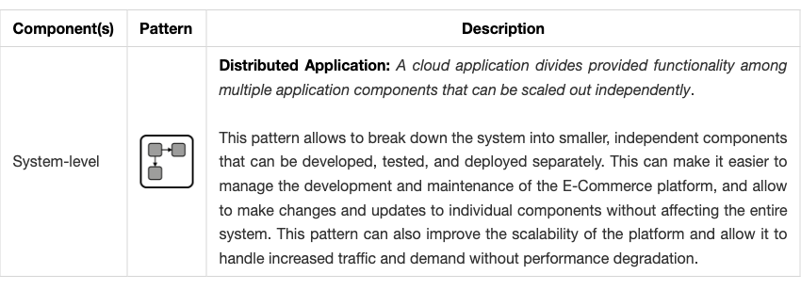
Fundamental Architecture Styles

Slide 18
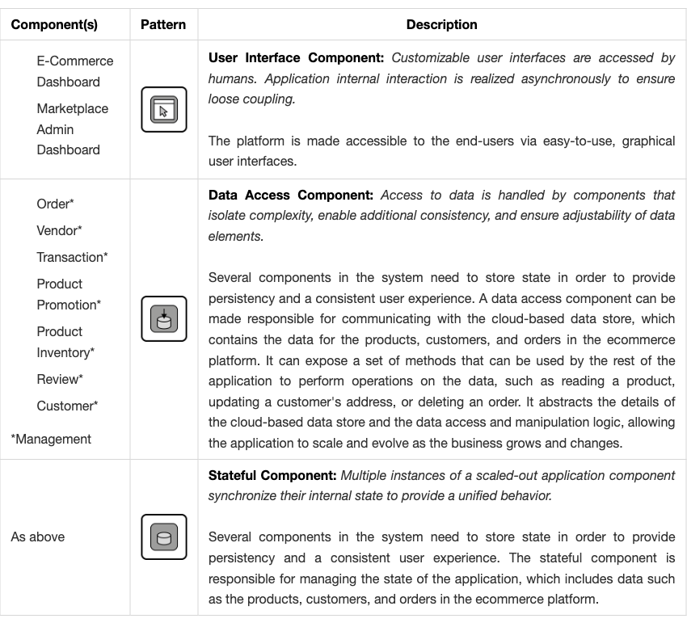
Application Components

Slide 19
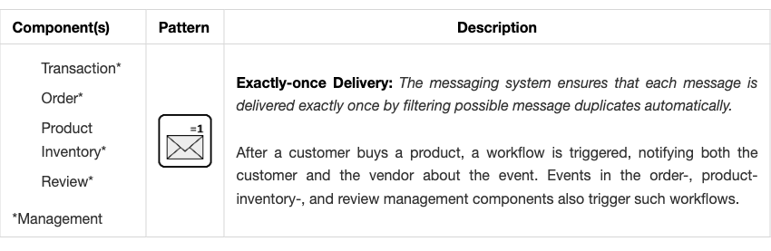
Communication Offerings

Slide 20
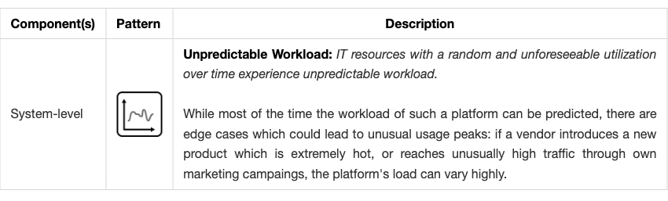
Application Workloads

Slide 21
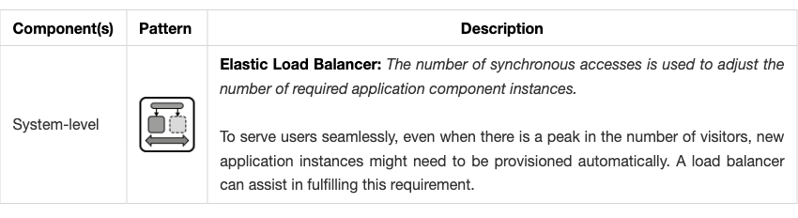
Application Management

Slide 22
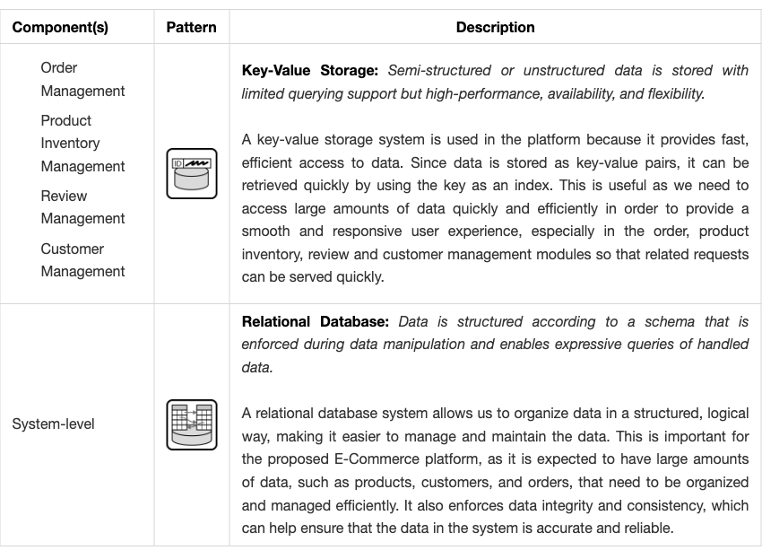
Storage Offerings

Slide 23
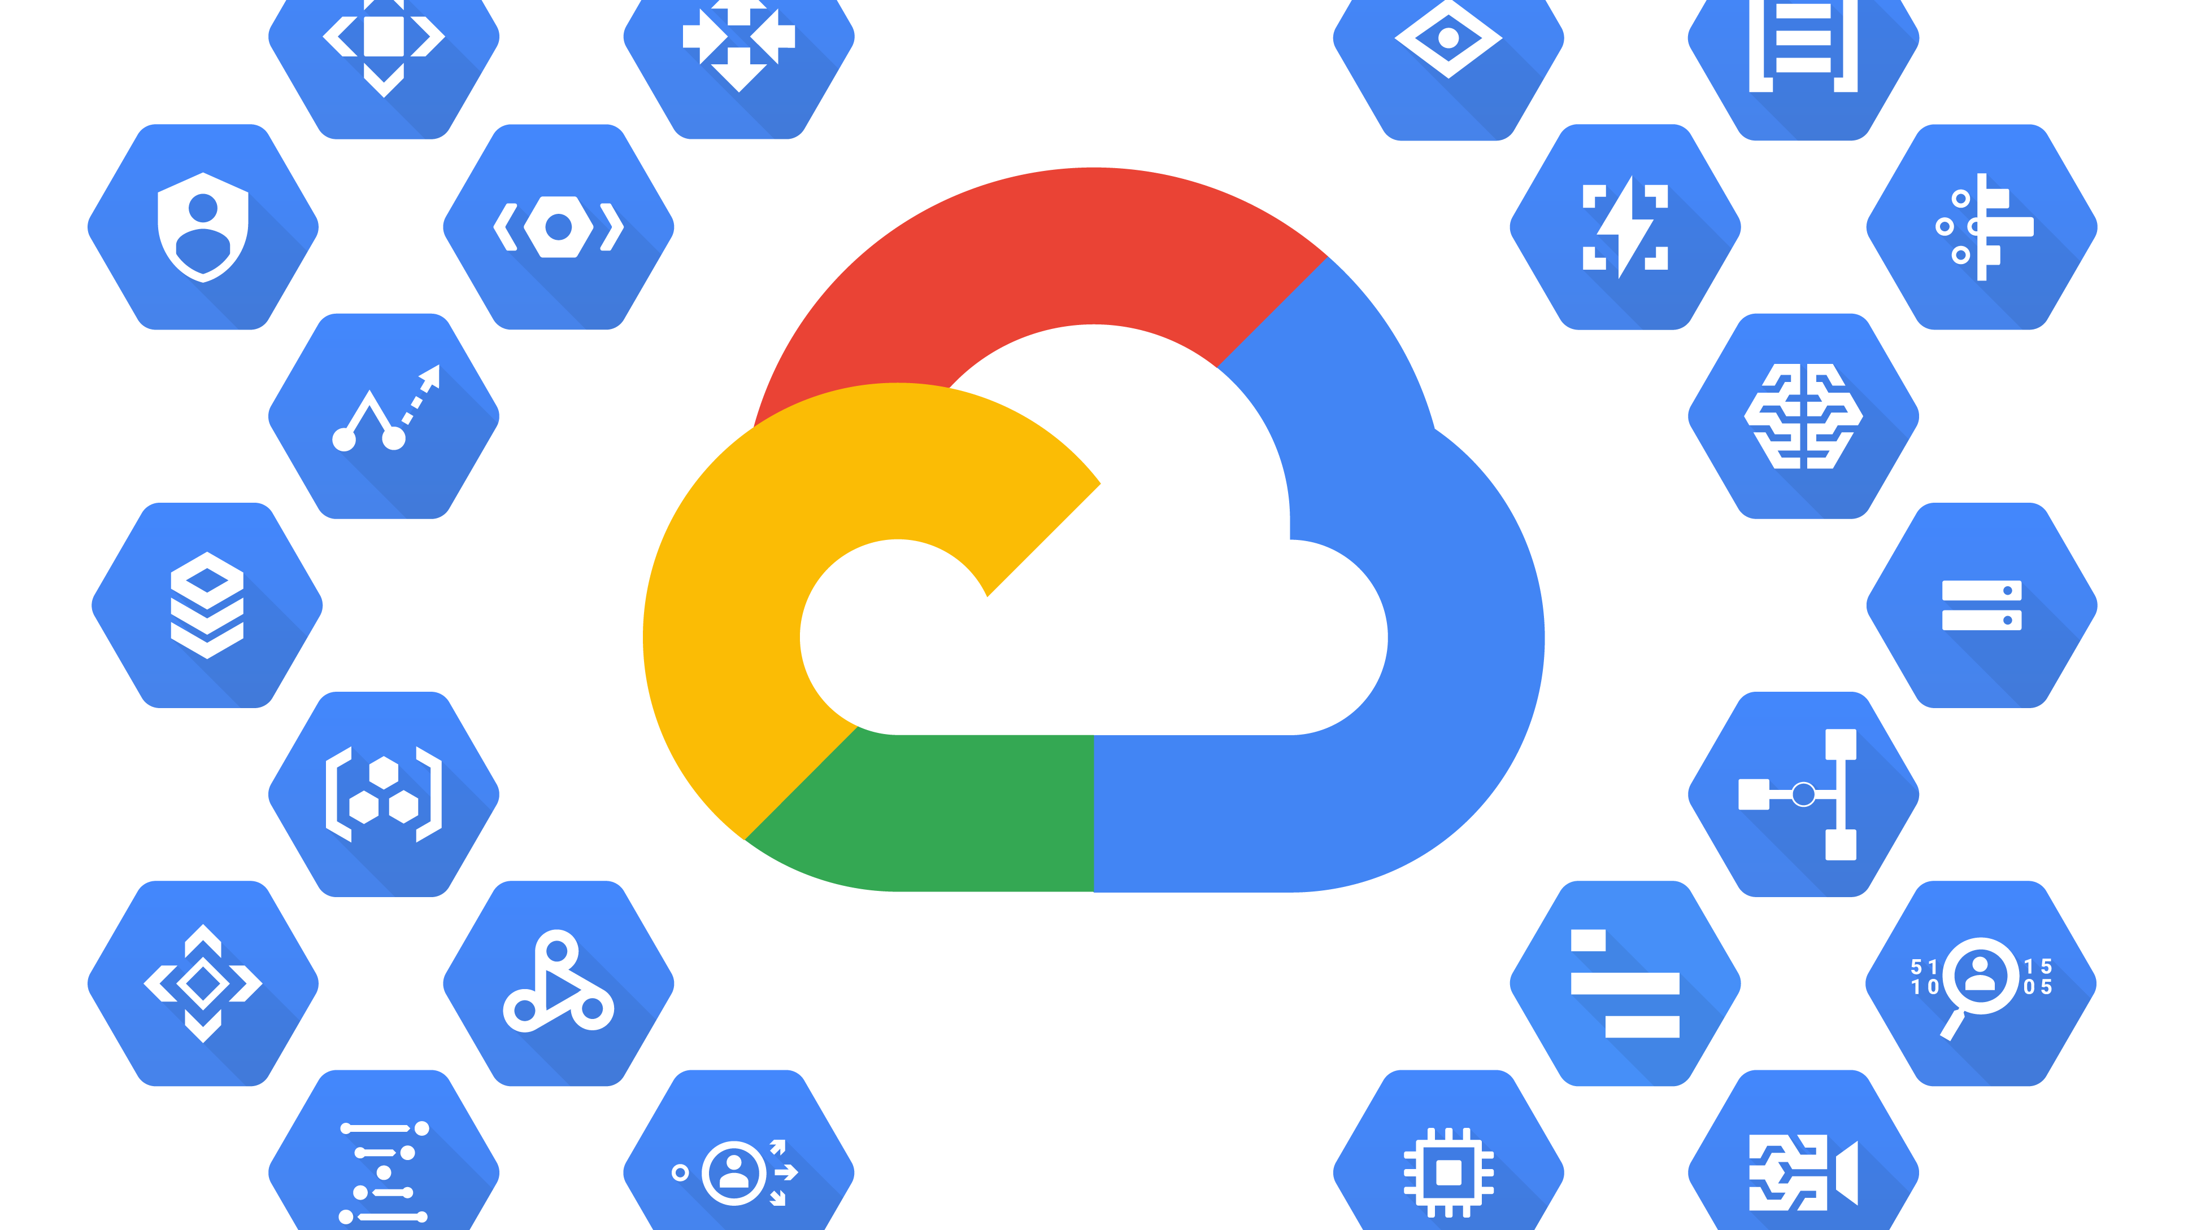
Vendor Specific Cloud Patterns

Slide 24
Emphasis on Cloud Portability
Designed system components based on Open Source packages
GCP provides only the infrastructure, the components could be hosted anywhere
Attempts to avoid vendor lock-in

Slide 25
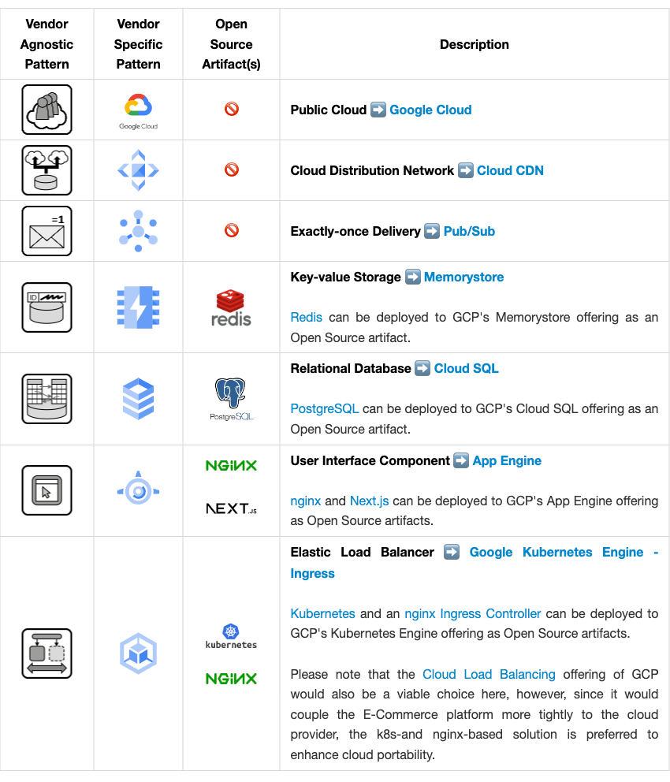

Slide 26
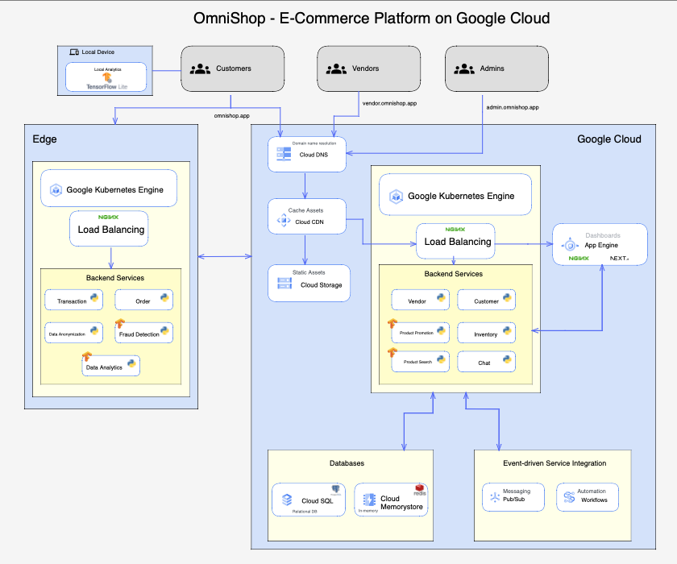
Vendor-specific Architecture

Slide 27

Modeling with OpenTOSCA

Slide 28
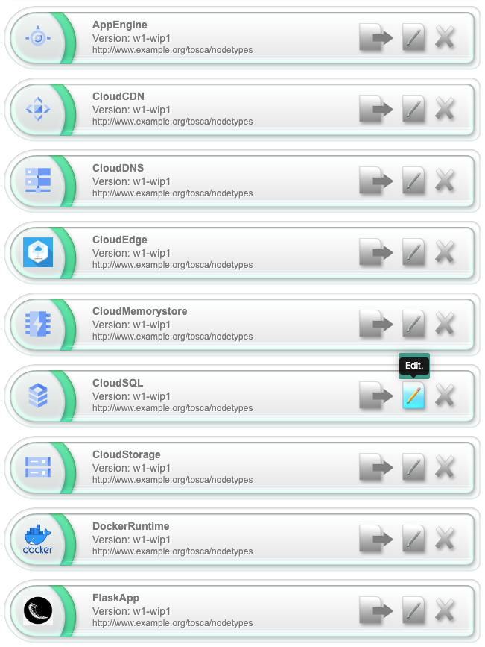
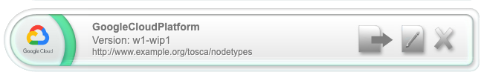
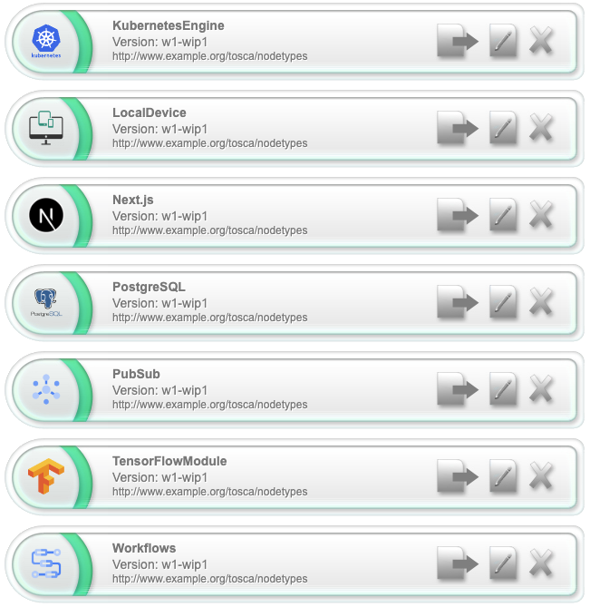
Created OpenTOSCA Resources

Slide 29
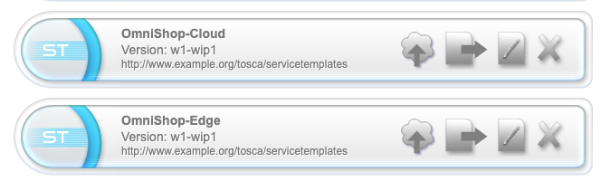
Created OpenTOSCA Resources

Slide 30
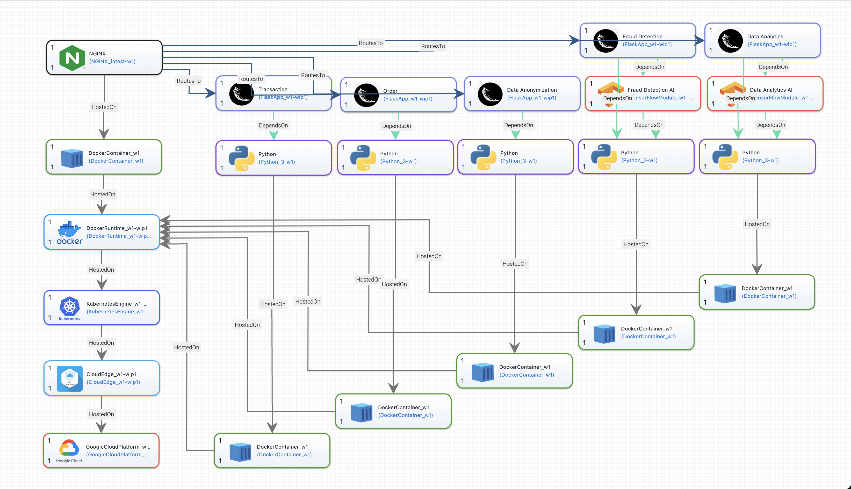
OpenTOSCA Topology Edge

Slide 31
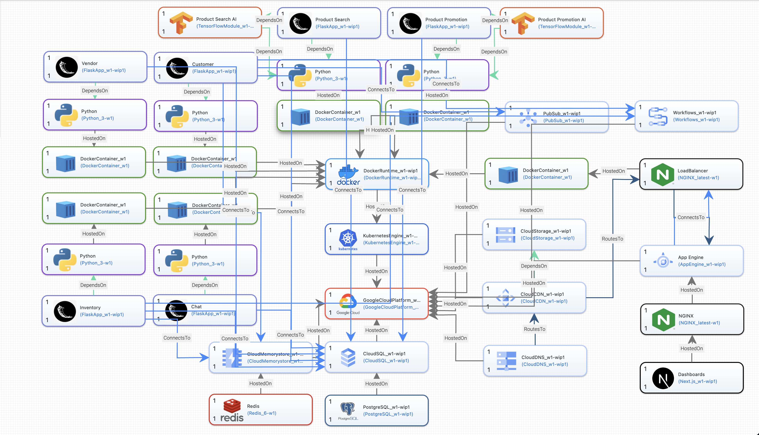
OpenTOSCA Topology Cloud

Slide 32

Discussion

Slide 33
Thank you for your attention!

Slide 34
References
https://dub.sh/11913446-cloud-arch
https://miro.medium.com/max/7746/1*Iq5850WkFXq1BoDEKE2RDw.png

